Slide 1
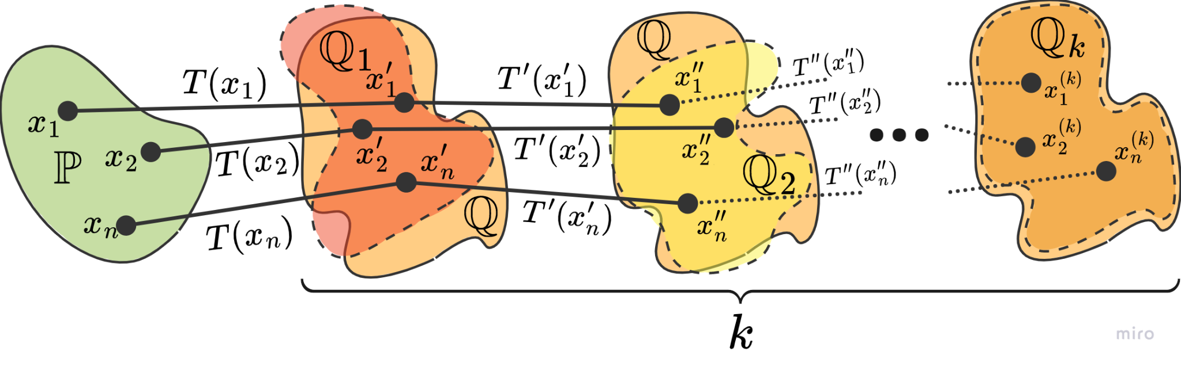
Stacking Neural Optimal Transport
Machine Learning 2023
Final project
Team 4:
Mikhail Vulf, Matvey Skripkin, Antonina Kurdyukova, Nikita Ligostaev, Mikhail Koksharov
TA:
Nikita Gushchin
March 24, 2023

Slide 2
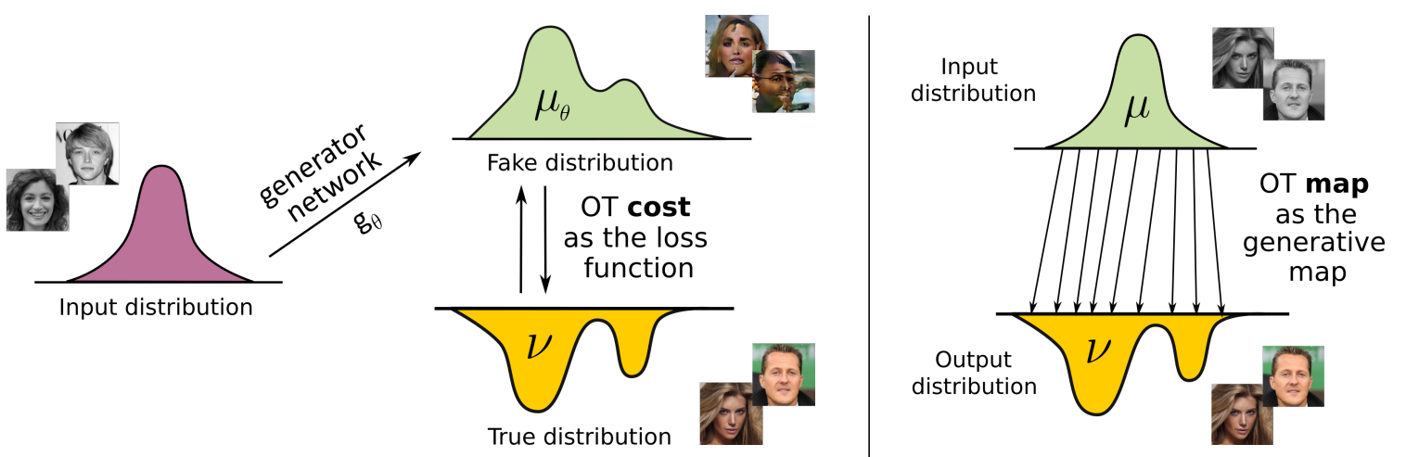
Problem Statement
Problem we solve: transformation of one probability distribution to another
Optimal transport: how to move (map) one distribution of mass of data to another as efficiently as possible
Difference between WGAN (left)¹ and OT (right)²
1 https://doi.org/10.48550/arXiv.2201.12220
2 https://doi.org/10.48550/arXiv.2110.02999

Slide 3
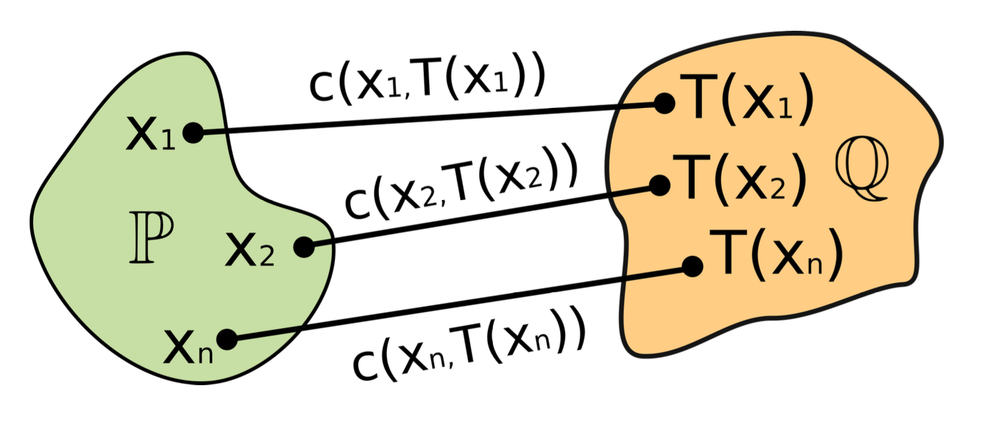
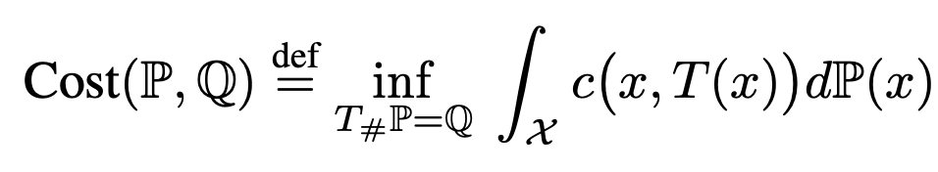
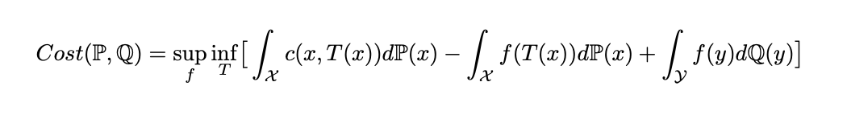
Dual Problem
Strong OT formulation¹:
Monge’s OT formulation
Maxmin reformulation of the dual problem¹:
Parameterize f and T by θ, φ via neural networks,
Fix f and solve the inner optimization problem,
Fix T and solve the outer problem.
1 https://doi.org/10.48550/arXiv.2201.12220

Slide 4
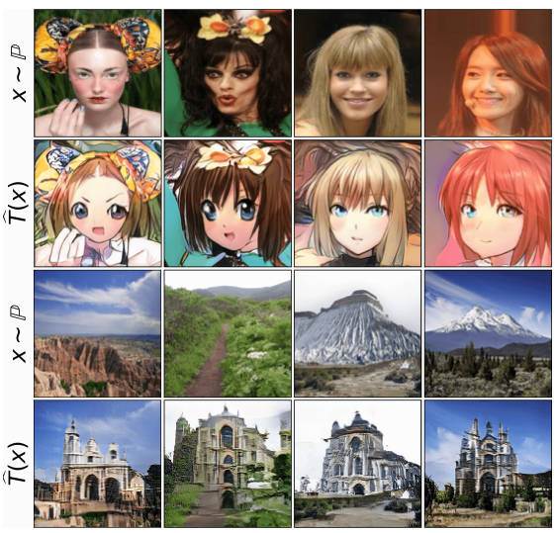
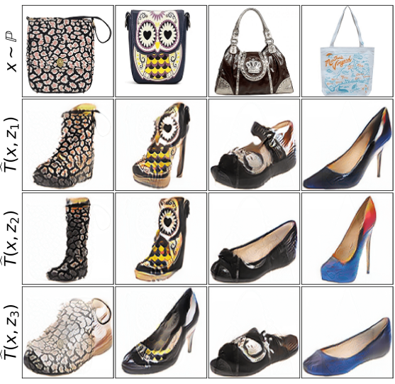
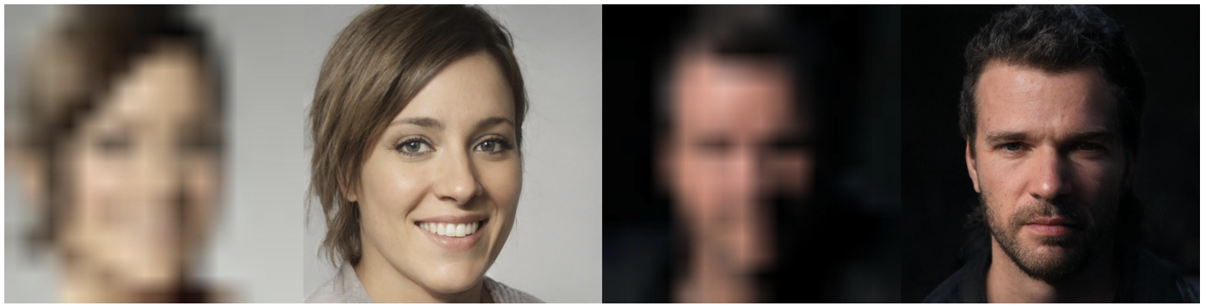
Motivation
Practical tasks:
Style (domain) translation – input sample is transferred to another domain, saving its key features,
Super-resolution images generation,
Solving problem of unpaired datasets.
Style translation of female to anime, landscape to church (deterministic)¹
Image-to-image translation (super-resolution)²
Style translation of shoes to handbags (stochastic)¹
1 https://doi.org/10.48550/arXiv.2201.12220
2 https://doi.org/10.1109/cvpr46437.2021.00232

Slide 5
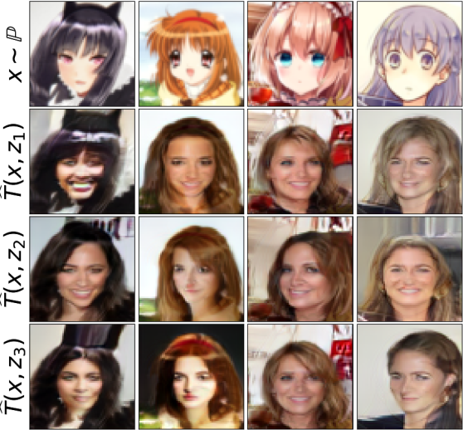
Idea description
How to improve Optimal Transport?
Hypothesis: stacking-like approach improves the performance of model (FID gets less). Goal is to outbid own score (before applying stacking).
Stacking: repeat mapped distributions. Output distribution serves as input for new iteration.
FID: compare distribution of generated and real images.
Translation of anime to female (stochastic)¹
1 https://doi.org/10.48550/arXiv.2201.12220

Slide 6
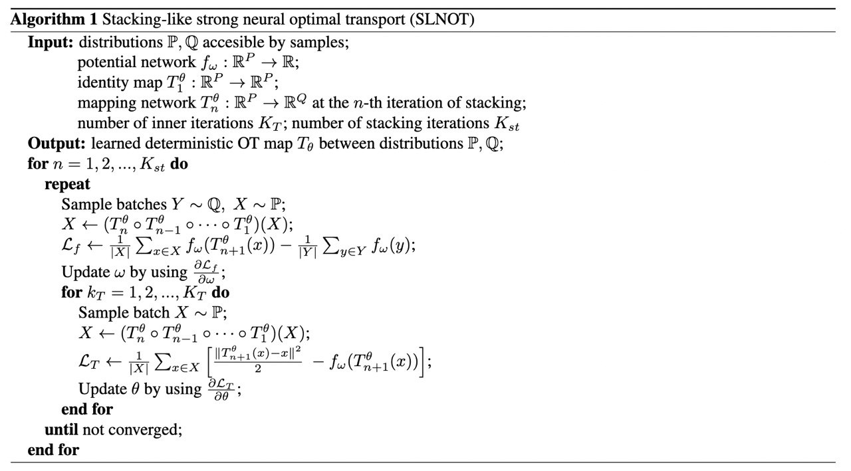
Algorithm

Slide 7
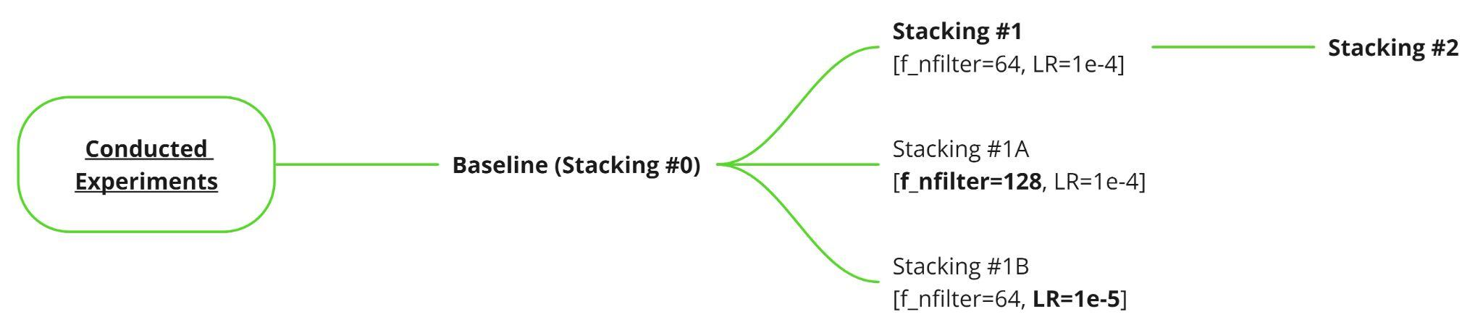
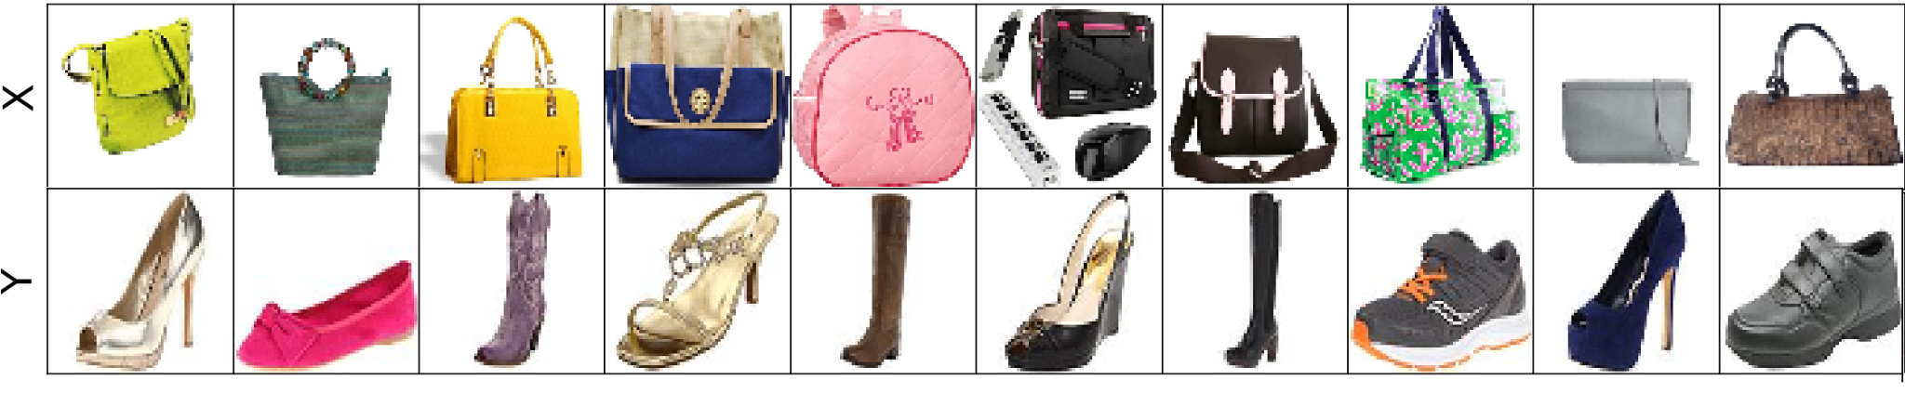
Conducted experiments
Input Data

Slide 8
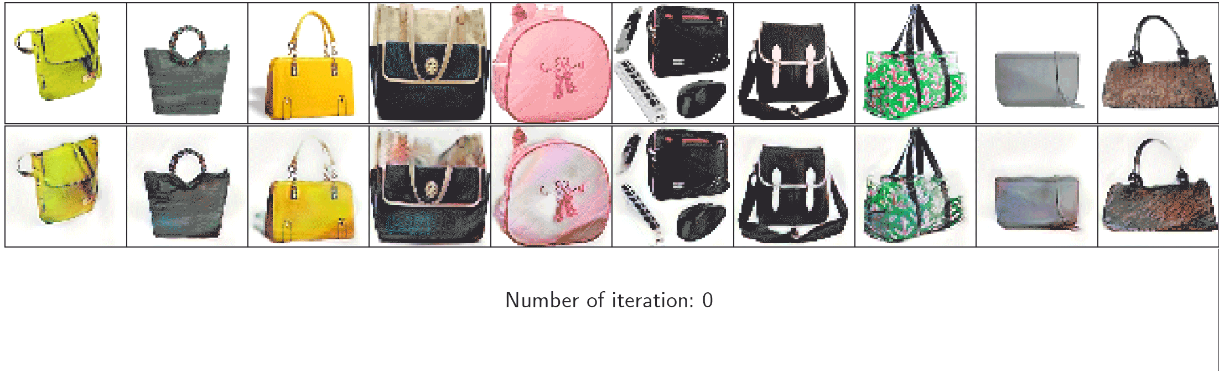
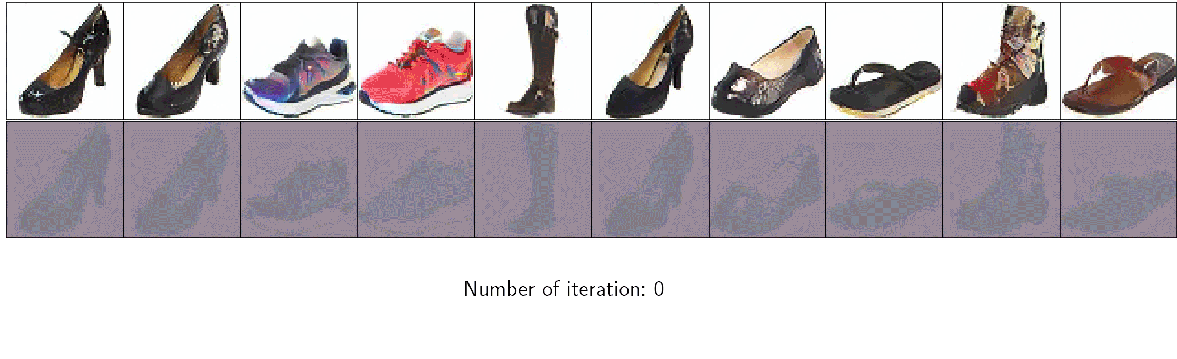
Obtained Results. Transport images
Baseline
Stacking #1

Slide 9
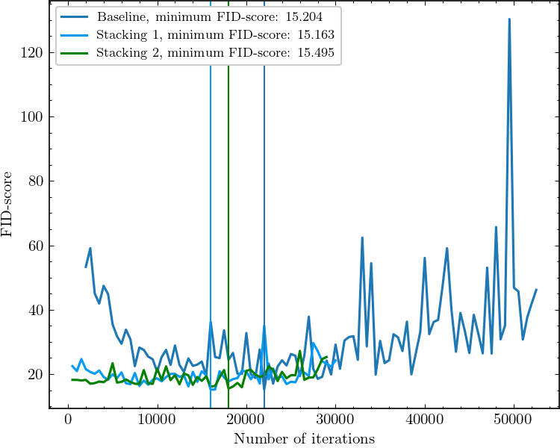
Obtained Results. Stacking FID
Best FID-scores by Stacking
Stacking name | FID-score
Baseline (Stacking 0) | 15.204
Stacking 1 | 15.163
Stacking 2 | 15.495

Slide 10
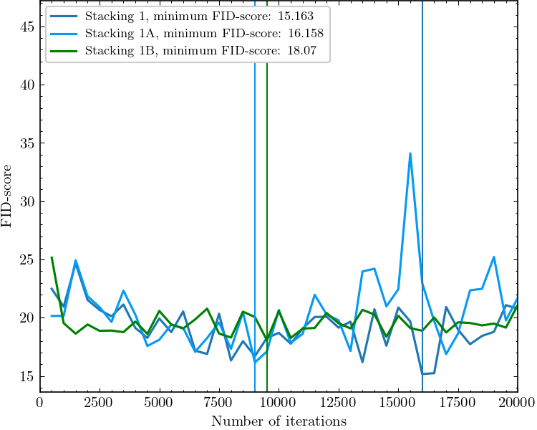
Obtained Results. Hyperparameter search
Best FID-scores by Hyperparameters search
Name | FID-score | f_nfilter | Lr
Stacking 1 | 15.163 | 64 | 1e-4
Stacking 1A | 16.158 | 128 | 1e-4
Stacking 1B | 18.07 | 64 | 1e-5

Slide 11
Conclusion
Thus, statistically significant improvement of the FID-metric is not achieved
Recommendation: Check Stacking-like approach on Weak NOT

Slide 12
Backslides

Slide 13
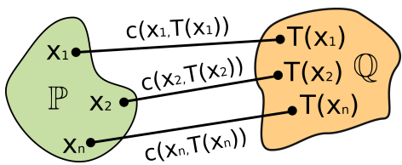
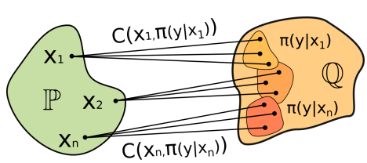
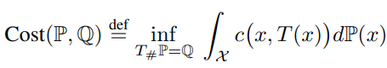
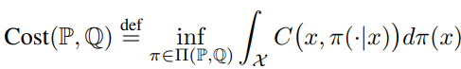
Strong vs Weak OT
Strong optimal transfer and its optimization problem (Monge's OT formulation)¹
Weak optimal transfer and its optimization problem¹
1 https://doi.org/10.48550/arXiv.2201.12220

Slide 14
baseline
Stacking #1

Slide 15
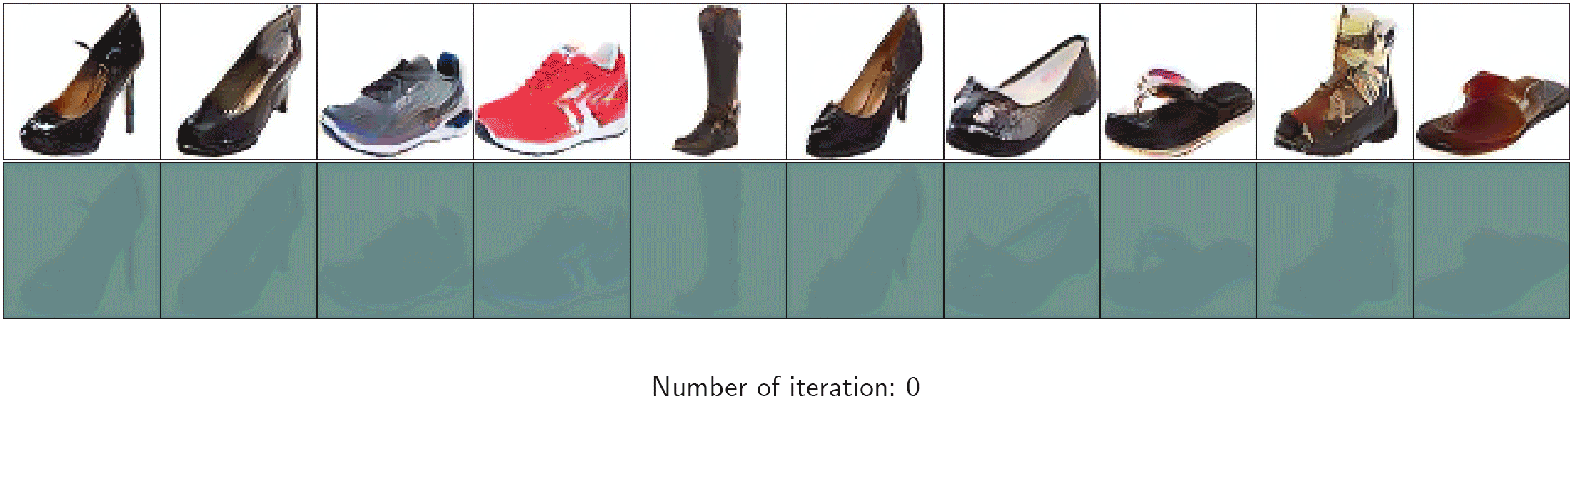
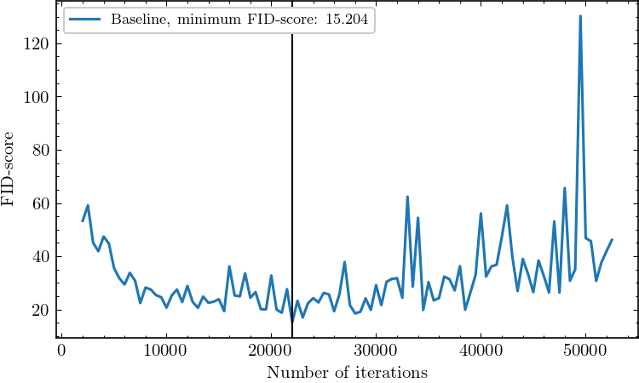
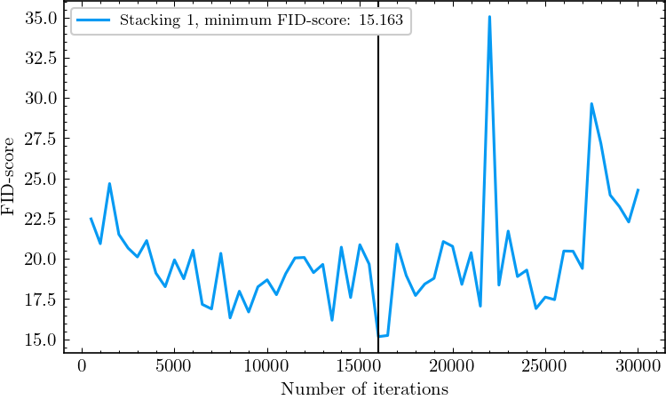
Stacking #2

Slide 16
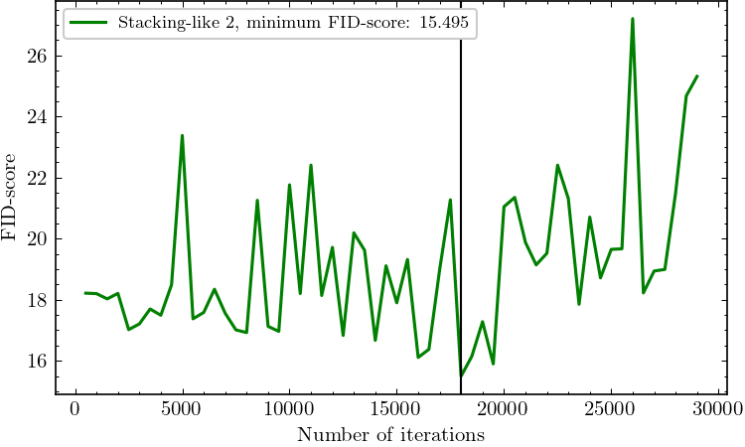
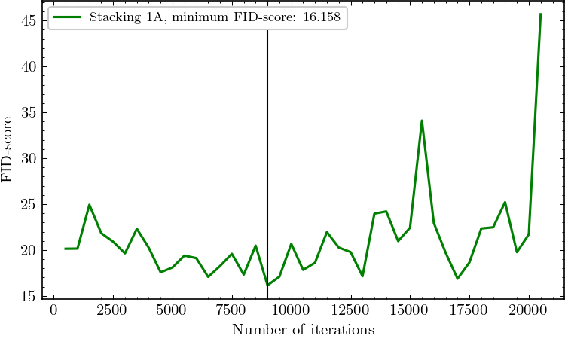
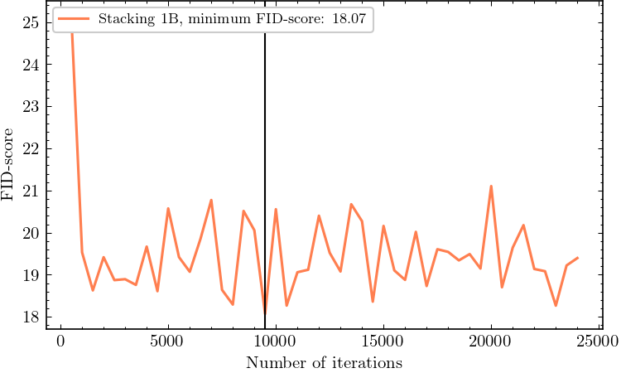

Slide 17
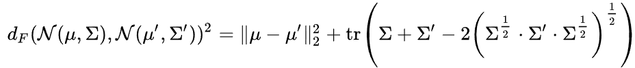
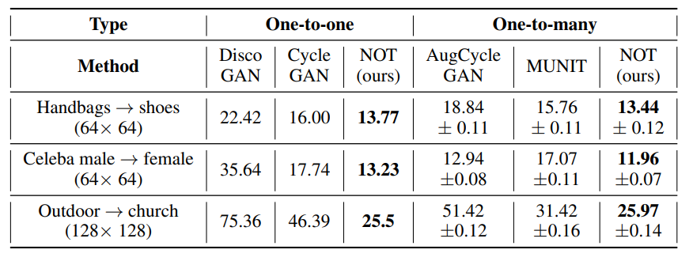
Fréchet inception distance
Compare images not pixel by pixel, but with mean and std of deepest layer in “Inception v3” network
Formulation of FID:
“Inception v3” model is trained on the ImageNet, however without final classification layer (2048-dimensional activation vector of its pool3 layer).
Comparison of FID for various models¹
1 https://doi.org/10.48550/arXiv.2201.12220

Slide 18
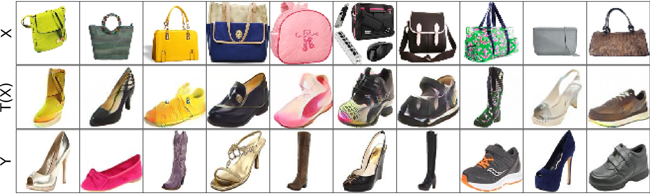
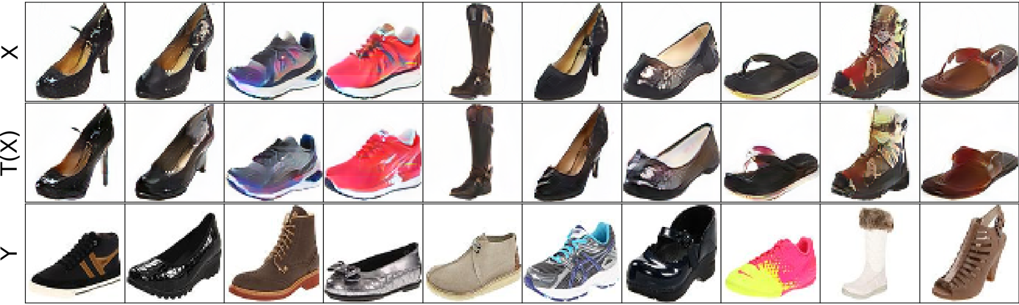
baseline
Stacking #1

Slide 19
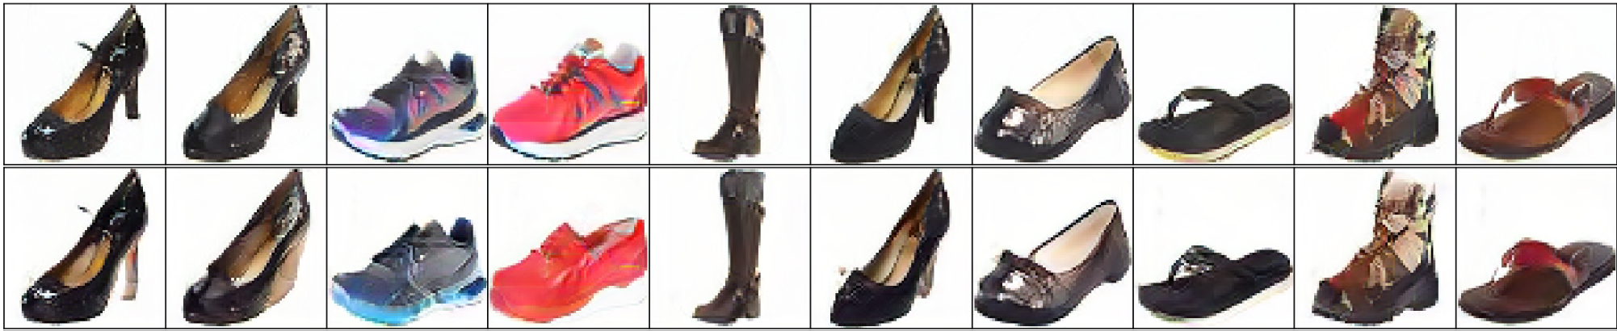
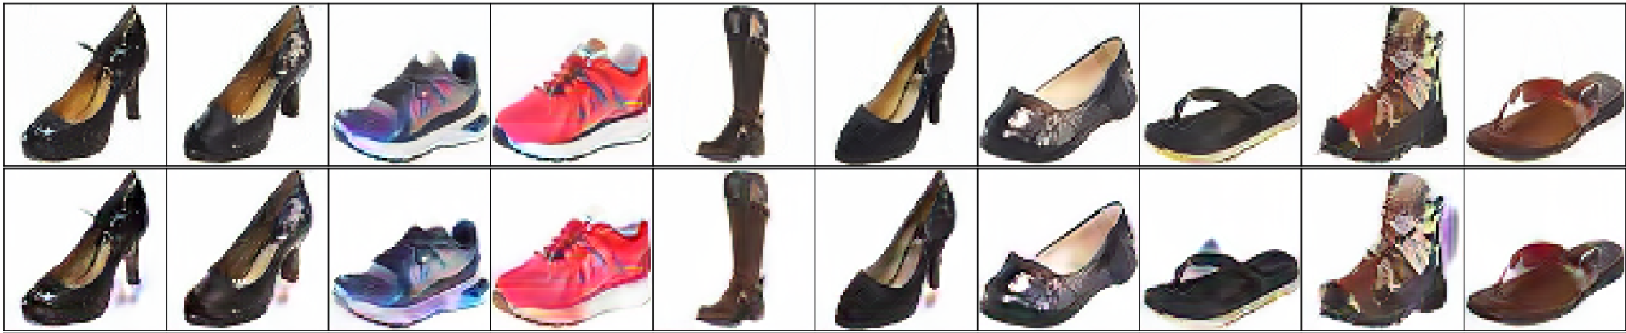
Stacking #1A
Stacking #1B

Slide 20
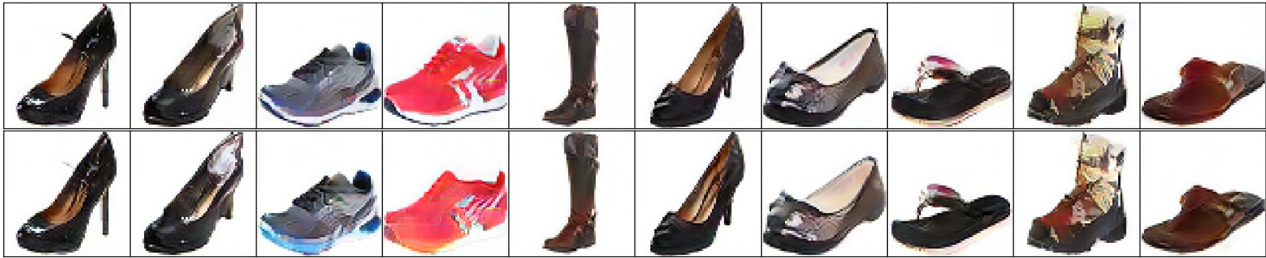
Stacking #2

